Slide 1

CS47: Cross-Platform Mobile Development
Lecture 3A: User-Interactive Components (TextInput + Lists)
James Landay
Abdallah AbuHashem
Tiffany Manuel
Cisco Vlahakis
Vy Mai
Fall 2019
https://cs-47.stanford.edu
cs-47.slack.com
Notes:
Welcome to the first part of Lecture 3. Today we’re going to talk about user interactive components.
This includes the TextInput and Lists

Slide 2

Live Exercise
To-Do List
Run npm install
Open with Expo

Slide 3
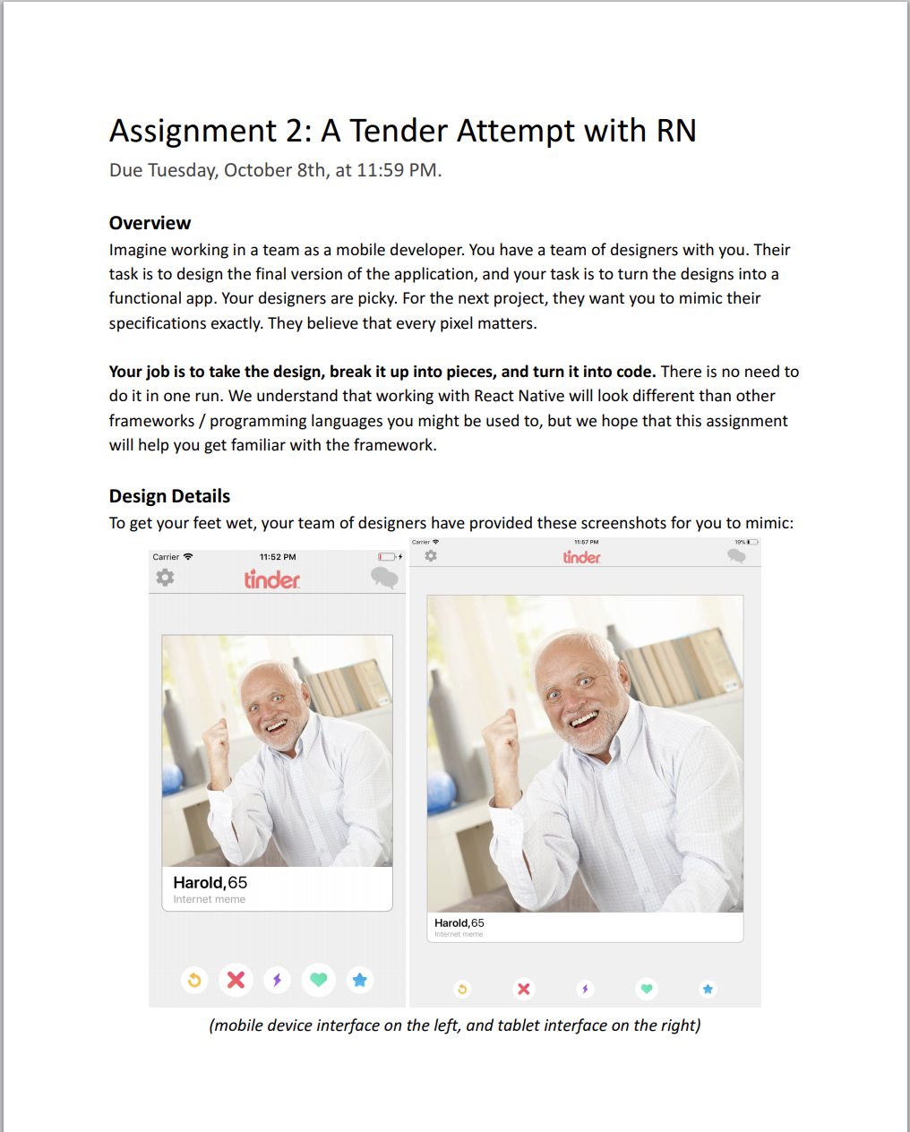
Due Today, Tuesday October 8th
Notes:
Assignment 2 is due today by 11:59 PM FYI

Slide 4
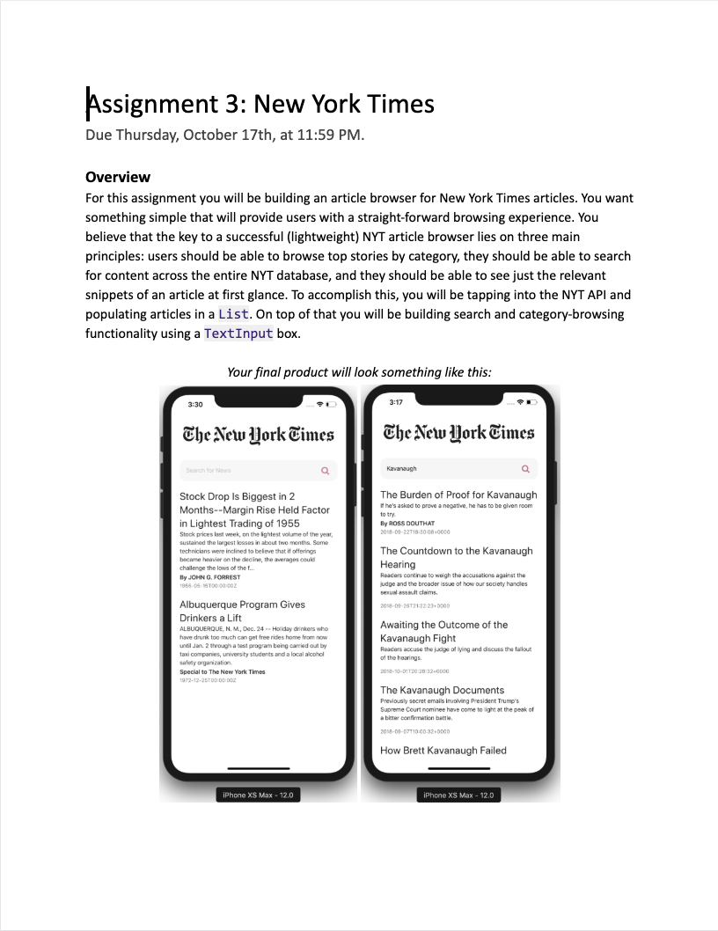
Due Thursday, October 17th
Notes:
Assignment 3 is released today
Tiffany’s OH moved to 4pm on Thursday in Huang basement bc career fair

Slide 5

Overview for today
Functional Components (from Thursday’s lecture)
Live demos (throughout lecture)
TextInput
ScrollView
Lists
Flatlist
SectionList
To-Do list Demo
Advanced: Infinite Scroll
Notes:
Flexbox: recap from last lecture.

Slide 6
Functional Component
A Component that is declared like a JS function.

Slide 7
Functional Component
A Component that is declared like a JS function.
const App = () => {
return ( <View style={styles.container}> <Text>Hello World!</Text> </View>
);
}

Slide 8
Functional Component
A Component that is declared like a JS function.
const App = (greeting) => {
return ( <View style={styles.container}> <Text>{greeting}</Text> </View>
);
}
Notes:
Since it is a function, you can pass in variables like you would to a normal function. This is equivalent to passing a prop into a class component.
What if we wanted to make a functional component interactive too? Until recently, we weren’t able to because there was no state in functional components. Then, React introduced a way to apply the state feature to functional components.

Slide 9
Hooks
Functions that allow you to “hook into” React state and life cycle features from function components.
Notes:
We’ll talk about component life cycles later in the course.

Slide 10
Hooks
Functions that allow you to “hook into” React state and life cycle features from function components.
Two Rules of Hooks
1) Only call Hooks at the top level
2) Only call Hooks from React
functional components
Notes:
Only call Hooks at the top level. Don’t call Hooks inside loops, conditions, or nested functions.
Only call Hooks from React function components. Don’t call Hooks from regular JavaScript functions.
There are a few built-in hooks already provided by React, but for now we will just look at one: useState.

Slide 11
state object
(Class Components)
useState Hook
(Functional Components)
const [x, setX] = useState(z)
setX(y)
import { useState } from 'react';
state = { x: z }
this.setState({ x: y })
Functional Components
Hooks
Notes:
We already know about the state object that we can use with class components, and the useState Hook is basically the same idea, but with functional components.
Array destructuring.

Slide 12
How would you change the code for our Jedi ID Card to use functional components and the useState Hook (instead of
class components and props/state)?
(We’ll leave this as a highly recommended exercise,
but the solution can be found here.)
USEFUL LINKS / React Hooks

Slide 13
Overview for today
Functional Components (from Thursday’s lecture)
Live demos (throughout lecture)
TextInput
ScrollView
Lists
Flatlist
SectionList
To-Do list Demo
Advanced: Infinite Scroll
Notes:
Flexbox: recap from last lecture.

Slide 14
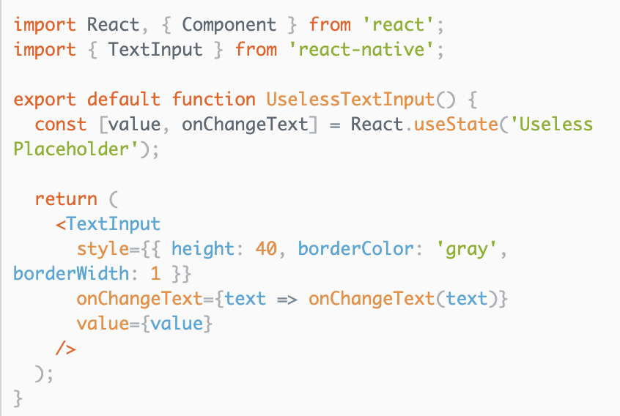
TextInput
Allows for the intake of text by the user
Two important props
onChangeText listens to keystrokes
value displays the text itself
Additional props
placeholder is text shown when nothing is typed
Snack: https://snack.expo.io/BJNX1__xZ

Slide 15
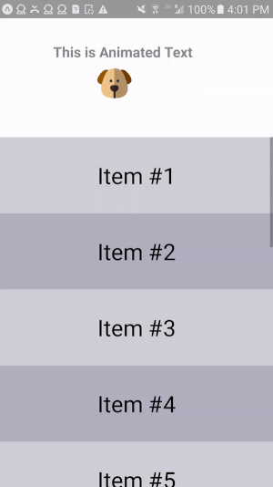
ScrollView
Basic View that allows for scrolling
Renders all components at once
Slower performance and larger memory usage
Must bind height to render correctly
ScrollView “works best to present a small amount of things of a limited size”.
Snack: https://snack.expo.io/SySerKNp-

Slide 16
Lists: FlatList and SectionList
Fully Cross-Platform
Header/Footer Support
Pull to Refresh
Horizontal Scrolling
Column Support
https://facebook.github.io/react-native/blog/2017/03/13/better-list-views

Slide 17
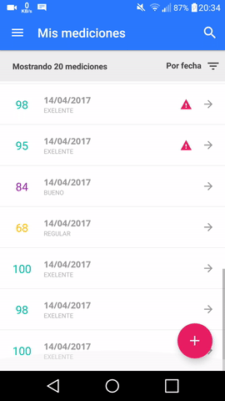
FlatList
Allows for the display of a list with scrolling built in
Three important props
data accepts JSON
renderItem returns the particular piece of the Flatlist
This is where you specify the UI layout of each JSON object
keyExtractor returns a unique key for every item
Common cause of YellowBox warnings is to incorrectly assign keys
Snack: https://snack.expo.io/@bacon/flatlist

Slide 18
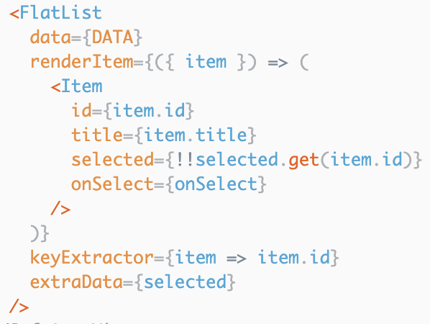
FlatList
Array of objects
Returns an object that represents an instance of the data array
Extracts which field should be read as the key, usually an id

Slide 19
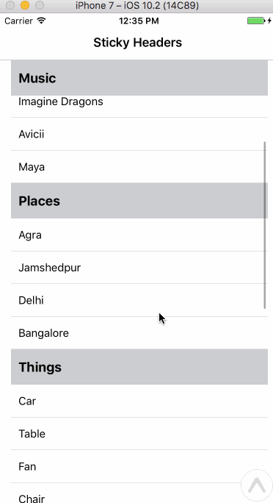
SectionList
Allows for the display of a list + scrolling + header and separators
Four important props
renderItem lets you set the layout of a single item
renderSectionHeader lets you set the layout of the section headers
sections is a JSON that maps each section to the data underneath it
keyExtractor returns a unique key for every item
Snack: https://snack.expo.io/@bakabon86/section-list

Slide 20
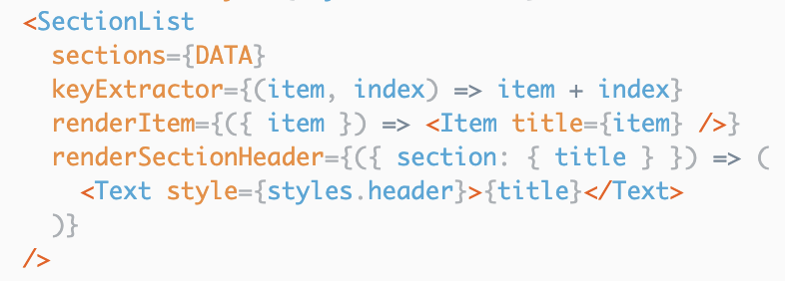
SectionList
Returns header of a section

Slide 21
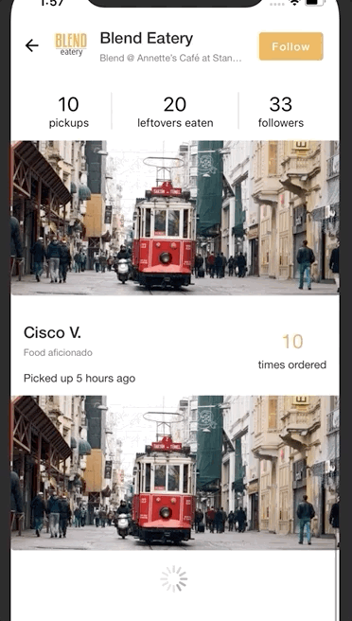
Infinite Scroll
What do you do when you need to render many items fetched from a database or endpoint?
If a database stores 10,000 images and they are to be displayed as a feed, it is unwise to fetch all 10,000 images at once
Instead, fetch a few items at a time, then load more when the user has reached the end of the List
This concept is called Infinite Scroll
FlatList and SectionList have a prop called onEndReached that accepts a callback.
This is where you should write the logic to load more items

Slide 22
Live Demo
SectionList + Infinite Scroll
Let’s look at an application that has a list with:
Customized items
Sticky headers
Infinite Scrolling
Pull down to refresh
Fetches info from a server
Handles Concurrent Calls

Slide 23
Live Demo
SectionList + Infinite Scroll
Run npm install
Open with Expo

Slide 24
Live Exercise
To-Do List
Create an application that appends notes to a to-do list.

Slide 25
Live Exercise
To-Do List
Run npm install
Open with Expo

Slide 26
Due Thursday, October 17th
Notes:
Discuss more at the end of class, if we have time.

Slide 27
CS47: Cross-Platform Mobile Development
Lecture 3A: User-Interactive Components (TextInput + Lists)
James Landay
Abdallah AbuHashem
Tiffany Manuel
Cisco Vlahakis
Vy Mai
Fall 2019
https://cs-47.stanford.edu
cs-47.slack.com

